Slide 1
RecSys 2026
CONFERENCE TAKEAWAYS
Lessons learned, personal takeaways and a first look at where they could take us.
Mohanish Sheth · 20th ACM Conference on Recommender Systems · Sep 29 to Oct 1, 2026
Notes:
10 minutes total. This is my read of the conference: four themes, what ties them together, and a directional view of what it means for us.

Slide 2
Four patterns across every session I attended
OVERVIEW
1
Semantic IDs
The path forward for cold, warm and hot start
2
Recommend to learn
Show items that teach us more about the user
3
Measurement we can trust
A/B testing is the gold standard for every release
4
LLMs and agents
Semantic IDs are the language LLMs use to recommend
Delivery RecSys tutorial, the CARS, OARS and RecTour workshops, paper and poster sessions
2
Notes:
I attended the delivery RecSys tutorial, three workshops and the paper sessions across three days. Everything grouped into these four themes. One line each, then a slide per theme.

Slide 3
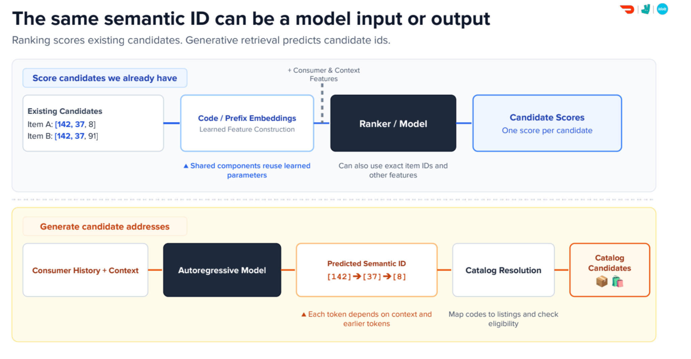
Semantic IDs are the path forward for cold, warm and hot start
THEME 1
DELIVERY RECSYS TUTORIAL
The same semantic ID can be a model input or output: score candidates we have, or generate new ones.
PREFIX N-GRAMS · COLD TO HOT
Coarse prefixes carry a shared, well-trained signal. Deep prefixes approach item-level memorization.
AMAP · 83.1M PLACES
Text, image, spatial and collaborative views fuse into one three-token ID.
Photo: Delivery RecSys tutorial
3
Notes:
A semantic ID is a short code path for an item, like [142, 37, 8]. Embed each prefix and sum them. A brand-new item still shares its coarse prefix with similar items, so it starts with a trained signal: that is cold start. A popular item gets its own detail from the deep prefix: that is hot start. One representation covers the whole range. Amap builds these IDs for 83.1 million places from four views of each place. Caveat from the tutorial if asked: today semantic IDs are used mostly for retrieval, not ranking.

Slide 4
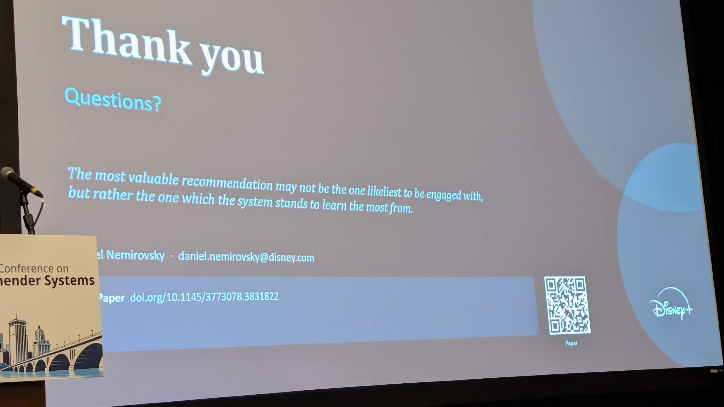
Recommend to learn: show items that teach us about the user
THEME 2
DISNEY+ · EPISTEMIC GAIN
The most valuable recommendation may be the one the system stands to learn the most from.
HOW THEY SHIP IT
One extra head on the frozen relevance model. Nothing about the base model changes.
DELIVERY RECSYS TUTORIAL
Measure it: trial rate, and MRR on items the user has never purchased.
Photo: Epistemic gain for latent interest discovery, Disney+
4
Notes:
A relevance model trained only on history keeps recommending what it already knows, and the user ends up in a filter bubble. The Disney+ team asks a different question: what should I recommend to learn more about this user? They score each item by how much the model's picture of the user would change if the user engaged or did not. To make it practical they add one small head on the frozen model. The tutorial gave the metric to go with it: do not only track MRR, track trial rate and MRR on never-purchased items. Their own caution: recommending obscure items purely to learn can erode user trust, so blend it with relevance.

Slide 5
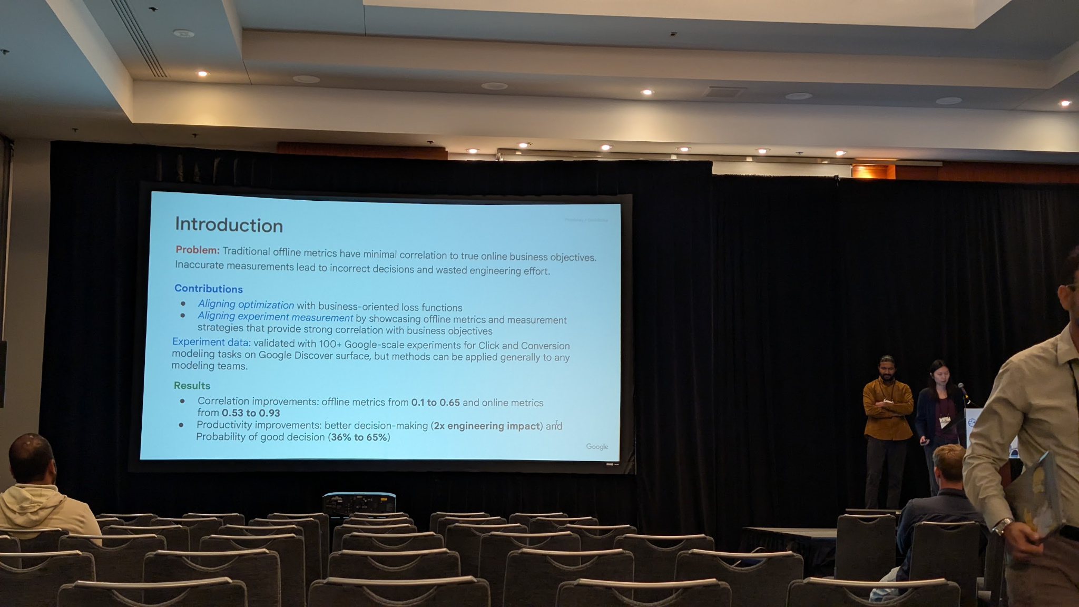
A/B testing is the gold standard for every release
THEME 3
REWARD OPTIMIZING TUTORIAL
The target is business metrics as measured at A/B test time.
GOOGLE · 100+ EXPERIMENTS
Traditional offline metrics have minimal correlation to true online business objectives.
OFFLINE EVALUATION STUDY
We don't know if better offline scores reflect true user preferences or just the biases of the evaluation setup.
Photo: A Framework for Value-Aligned Modeling and Robust Experimentation, Google
5
Notes:
This is the message I most want everyone to take away: there is more value in online testing than in polishing offline numbers. Three separate sessions said it. The reward optimizing tutorial defines the goal as business metrics measured at A/B test time. Google found traditional offline metrics barely correlate with online business objectives across more than 100 experiments. An academic study compared sparse offline evaluation with dense ground truth and could not tell whether better offline scores mean better recommendations. Another paper showed many reported gains shrink once tied scores are handled properly. If asked about the photo: Google raised the probability of a good decision from 36 to 65 percent by aligning offline measurement with online value, so offline still has a role as a filter before the A/B test.

Slide 6
How to run A/B tests we can trust
THEME 3 · IN PRACTICE
Run long
Certain behavior only shows in long-running A/B tests.
Wait for delayed signals
A user views an item first, then converts five days later.
Account for new users
First-time users (FTU) are part of the test setup.
Borrow cross-over trials
User, treatment A, wash-out, treatment B, then compare A and B.
Watch for confounding
Shared training across treatments violates the comparison.
Sources: Delivery RecSys tutorial · Reward optimizing recommender systems tutorial
6
Notes:
These are the practice tips I wrote down. Short tests and long-running tests show different behavior, so some effects only appear if we let the test run. Signals can be delayed: someone views an item and converts five days later, and a short test would miss it. Cross-over trials come from medicine: the same user gets treatment A, then a wash-out period, then treatment B, and we compare. The risk to watch is confounding when the treatments share training.

Slide 7
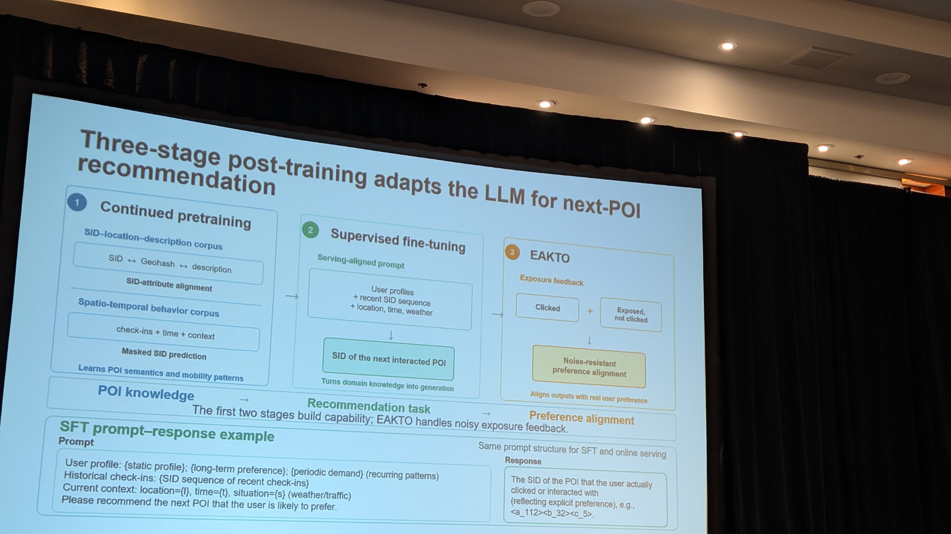
Semantic IDs are the language LLMs use to recommend
THEME 4
AMAP · SIDS IN, SID OUT
The prompt carries the user's recent check-ins as a SID sequence. The LLM answers with the SID of the next place.
AMAP · THREE-STAGE TRAINING
Align SIDs with location and description, fine-tune on the task, then align to real preferences.
DELIVERY RECSYS TUTORIAL
Each token depends on context and earlier tokens. Codes map back to catalog listings.
Photo: Guess Where You Go, generative next-POI recommendation in Amap
7
Notes:
This is why theme 1 matters for LLMs. An LLM cannot work with millions of arbitrary item IDs, but it can read and write a short token vocabulary. In Amap each place is three tokens. The prompt on the photo lists the user profile, the SID sequence of recent check-ins and the current context, and the response is the SID of the next place, which a lookup maps back to a real location. Training runs in three stages: continued pretraining that ties SIDs to geohash and description, supervised fine-tuning on the recommendation task, and a final preference alignment step that handles noisy exposure feedback. The speakers named better alignment between SID tokens and natural language as future work.

Slide 8
Where LLMs and agents are already doing the work
THEME 4 · IN PRACTICE
Cold start
LLM-PRIT
No shared users, no shared items. LLM profiles are built offline, with no LLM calls in the online prediction path.
Self-evolving ranker
YouTube
A Gemini-powered agent proposes reward changes that traditionally take an engineer several months of work.
Model selection
AgentRec
An agent picks which LLM to fine-tune at 38 to 60% of the cost of exhaustive fine-tuning, with near-oracle quality.
Agent as consumer
Keynote
What changes when the consumer of recommendations is an agent acting on the user's behalf?
Sources: LLM-PRIT · Self-Evolving Recommendation System · Which LLM to Fine-Tune · Who Are We Recommending To
8
Notes:
Four concrete examples. LLM-PRIT transfers across platforms that share no users and no items by having an LLM write profiles offline; serving stays cheap because there are no LLM calls online, and their slide showed about one millisecond of added mean latency. YouTube runs a dual-loop system where an agent generates hypotheses and code changes for the watch page ranker and people review them; I noted this as a good idea for automating our own experiments. AgentRec treats choosing a model to fine-tune as a recommendation funnel, cheap signals first. And the keynote raised the question of agents booking and buying for users, which changes what we optimize for. From the conversational session: with vague users, turns accumulate but information does not, so assistants must adapt to how each user talks.

Slide 9
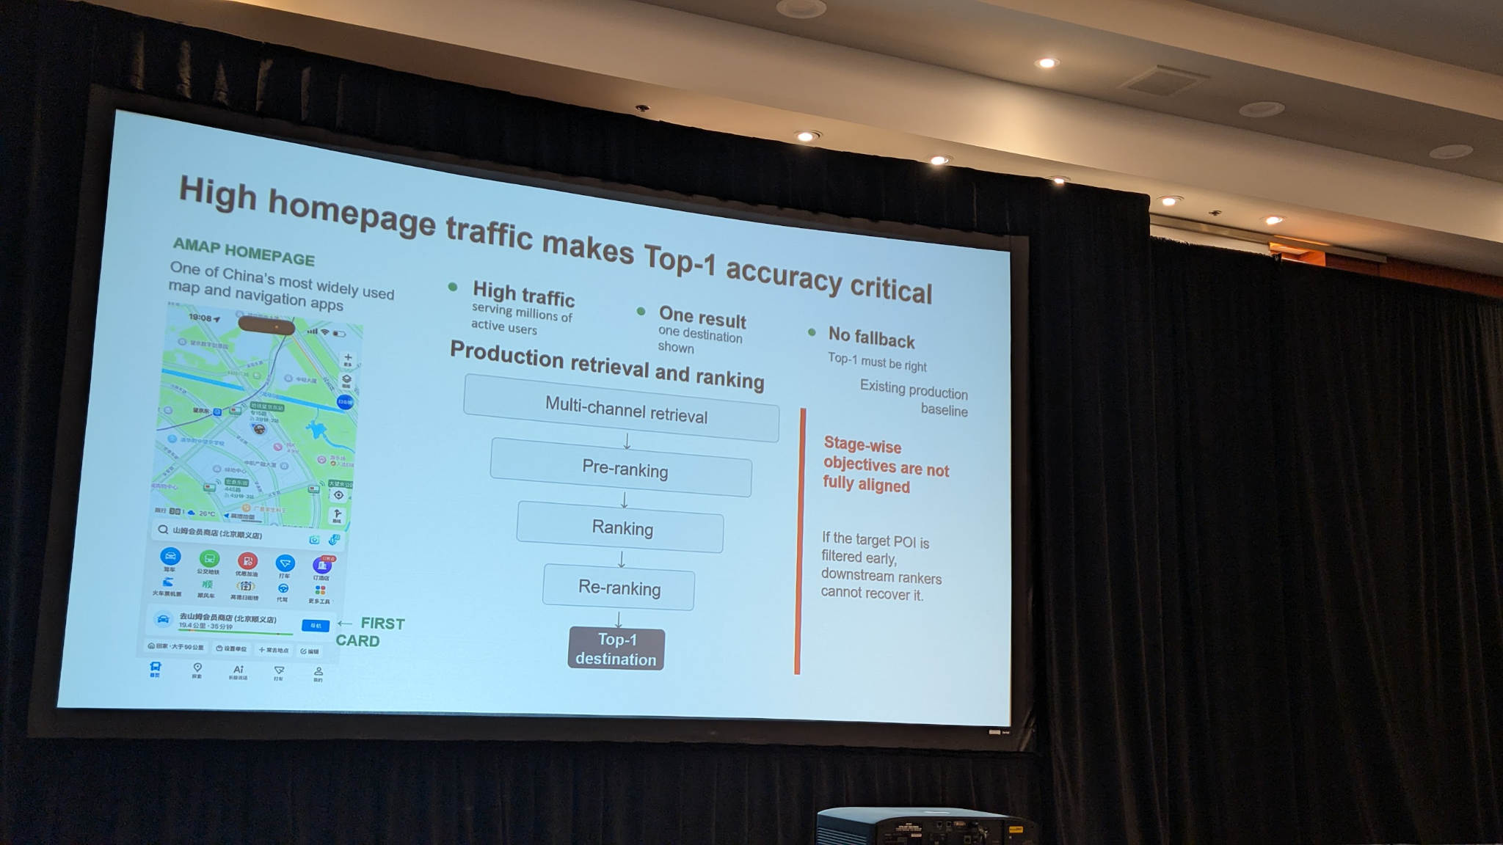
In travel, a wrong recommendation costs the user time and money
SPOTLIGHT · TRAVEL
AMAP HOMEPAGE
One destination shown, no fallback. The top result must be right.
WELFARE-ORIENTED RECOMMENDATIONS
A good match can still leave the user worse off if the activity is far away.
AMAP ROUTE RANKING
Compare where and why candidate routes differ, not just score each one independently.
Photo: Guess Where You Go, generative next-POI recommendation in Amap
9
Notes:
Travel is different from shopping because the user pays travel time, fuel and parking before finding out whether the recommendation was good, and those costs are not recoverable. The welfare talk models this as activity benefit minus travel cost and filters out recommendations likely to leave the user worse off. A related session added a safety score to next-place recommendations, noting travelers already ask LLM assistants for safe places.

Slide 10
From ranking what users clicked to learning what users want
A FIRST LOOK AHEAD
A shared item language
Exploration that counts
Semantic IDs across retrieval and LLMs
Measured and rewarded, not left to chance
Online proof for every release
Agents, with people in control
A/B testing as the standard
Conversation and automation that adapt to the user
Directional for now. Over the next few weeks I will work out how each applies to our day to day.
10
Notes:
This is a direction, not a roadmap. Four ideas I think are worth carrying into our work. I am not committing to specifics today; over the next few weeks I will think through how each can be used in our day to day and come back with concrete proposals.

Slide 11
What I am following up on
CLOSING
Read
MTGR: a generative recommendation framework at industrial scale
Follow up
Rank Mixer, from the MESH session
Request
The write-up on catalog normalization with agents and fine-tuned judge models
Thank you. Questions?
Paper links and full session notes available on request
11
Notes:
Three concrete follow-ups from my notes. Happy to share the full notes and paper links with anyone who wants to go deeper on a session.

